Slide 1
Divide-and-Conquer
7 2 ⏐ 9 4 → 2 4 7 9
7 ⏐ 2 → 2 7
9 ⏐ 4 → 4 9
7 → 7
2 → 2
9 → 9
4 → 4
Divide-and-Conquer
Notes:
Divide and Conquer

Slide 2


Divide-and-Conquer
Divide-and conquer is a general algorithm design paradigm:
  Divide the input data S in two or more disjoint subsets S₁, S₂, …
  Conquer the subproblems by solving them recursively
    base case for the recursion: If the subproblems are small enough just solve them
  Combine the solutions for S₁, S₂, …, into a solution for S
Analysis can be done using recurrence equations
Divide-and-Conquer

Slide 3
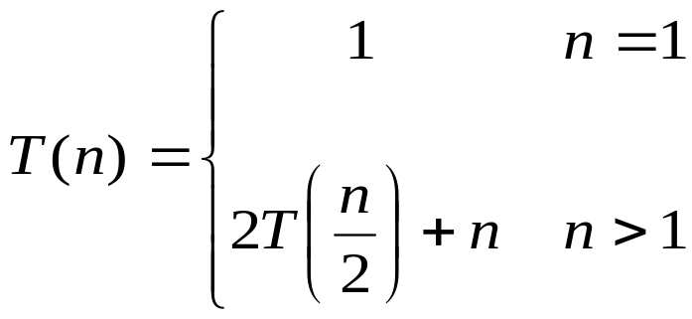
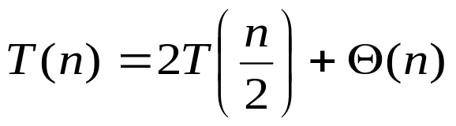
Mathematical Recurrences
A recurrence is a function T(n), that is defined in terms of its values with smaller inputs.
Example:
Usually we drop the base case from the definition.

Slide 4
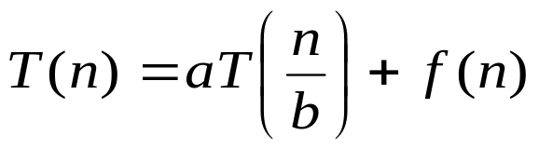
Mathematical Recurrences
Recurrences are used to represent the runtime of a recursive function
Cost of a recursive algorithm is equal to the cost of non-recursive part plus the recursive call on smaller input size.
We will be spending time looking at recurrences of the form
a is the number of times a function calls itself
b is the factor by which the input size is reduced
f(n) is the runtime of each function usually expressed in terms of Θ.

Slide 5
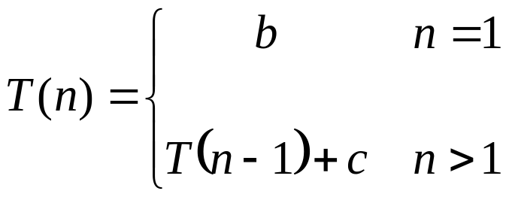
Recurrence Example
Factorial (n)
{
if (n == 1)
return 1;
else
return (n * Factorial(n-1));
}
The expression:
is a recurrence.

Slide 6
Solving Recurrences
  Three methods are used in “solving” recurrences
  The Substitution Method or Mathematical induction method
  The Recursion Tree Method
  The Master Method

Slide 7
  Mathematical Induction Method
Substitution method has two steps
  Guess the form of the solution
  Use induction to prove that the solution is correct
The substitution method can be used to establish an upper bound on difficult recurrences.
Its use is based on the strength of the guess
  applied in cases when it’s easy to guess the form of answer

Slide 8
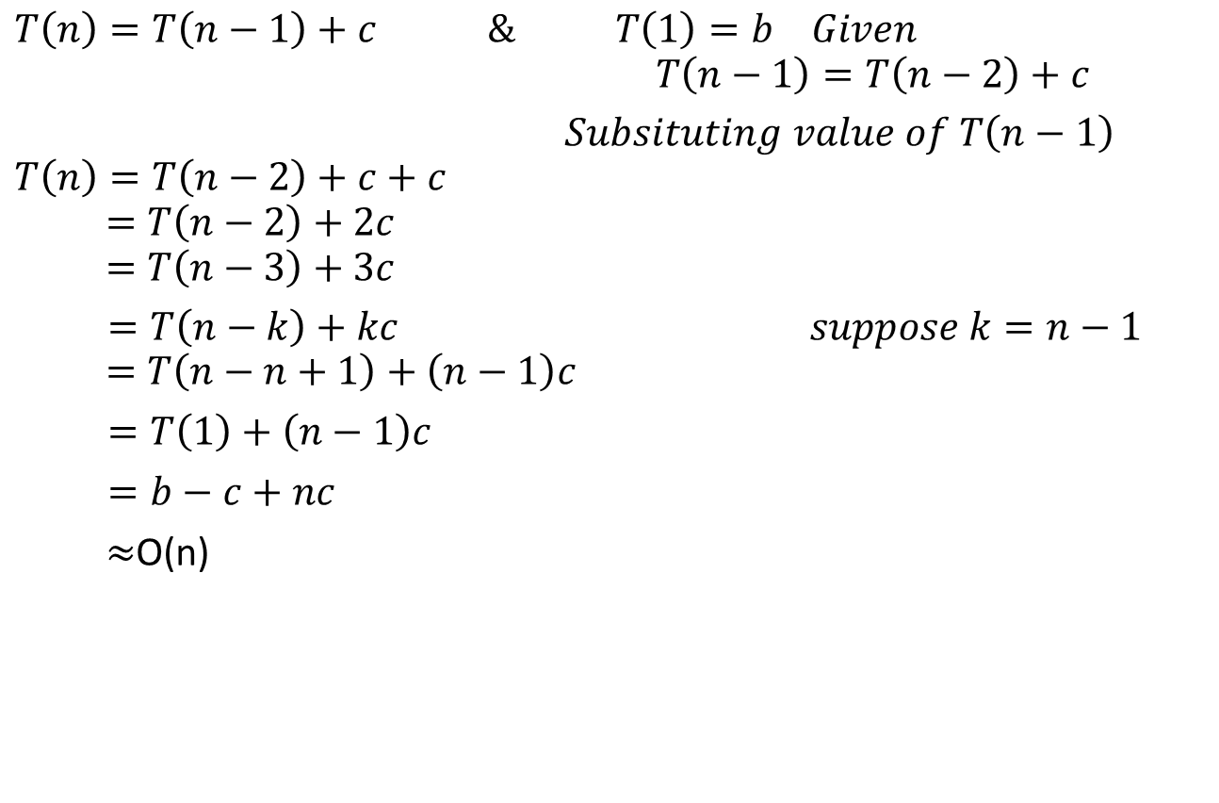
Recurrence Example
Divide-and-Conquer

Slide 9
Example: Sum of Queue
SumQueue(Q)
if (Q.length == 0 )
return 0
else
return Q.dequeue() + SumQueue(Q)
One subproblem
Linear reduction in size (decrease by 1)
Combining: constant (cost of 1 add)
Base
case
Subproblem size
T(0) ≤ b
T(n) ≤ c + T(n – 1) for n>0
1
# subproblems
Work dividing
and combining
Divide-and-Conquer
Notes:
Divide and Conquer

Slide 10

Sum of Queue Solution
Equation:
T(0) ≤ b
T(n) ≤ c + T(n – 1) for n>0
Solution: (finding the closed form solution)
T(n) ≤ c + c + T(n-2)
≤ c + c + c + T(n-3)
≤ kc + T(n-k) for all k
≤ nc + T(0) for k=n
≤ cn + b = O(n)
Iterative
substitution
method
Divide-and-Conquer

Slide 11
Example: Binary Search
Search a sorted array for a given item, x
  If x == middle array element, return true
  Else, BinarySearch lower (x<mid) or upper (x>mid) sub-array
  1 subproblem, half as large
BinarySearch(A, x)
if (A.size == 1) return (x == A[0])
mid = A.size / 2
if (x == A[mid]) return true
else if (x < A[mid]) return BinarySearch( A_LowerHalf, x)
else if (x > A[mid]) return BinarySearch( A_UpperHalf, x)
Find: 9
3 5 7 8 9 12 15
Divide-and-Conquer
Notes:
Divide and Conquer

Slide 12
Example: Binary Search
Search a sorted array for a given item, x
  If x == middle array element, return true
  Else, BinarySearch lower (x<mid) or upper (x>mid) sub-array
  1 subproblem, half as large
BinarySearch(A, x)
if (A.size == 1) return (x == A[0])
mid = A.size / 2
if (x == A[mid]) return true
else if (x < A[mid]) return BinarySearch( A_LowerHalf, x)
else if (x > A[mid]) return BinarySearch( A_UpperHalf, x)
Equation:
Base
case
Subproblem size
T(1) ≤ b
T(n) ≤ T(n/2) + c for n>1
1
Work dividing
and combining
Divide-and-Conquer
# subproblems
Notes:
Divide and Conquer

Slide 13
Binary Search Solution
Equation:
T(1) ≤ b
T(n) ≤ T(n/2) + c for n>1
Solution: (finding the closed form solution)
T(n) ≤ T(n/2) + c
≤ T(n/4) + c + c
≤ T(n/8) + c + c + c
≤ T(n/2^{k}) + kc
≤ T(1) + c log n where k = log n
≤ b + c log n = O(log n)
Iterative
substitution
method
Divide-and-Conquer

Slide 14
The Towers of Hanoi Puzzle
Some problems are computationally too difficult to solve in reasonable period of time. While an effective algorithm exists, we don’t have the time to wait for its completion.
Initially:
Three posts (named Left, Middle, Right)
N disks placed in order on the leftmost post
Goal:
Move all the disks on the leftmost post to the rightmost post
The original ordering must be preserved
Constraints:
Only one disk may be moved at a time.
Disks may not be set aside but must always be placed on a post.
A larger disk may never be placed on top of a smaller disk.

Slide 15
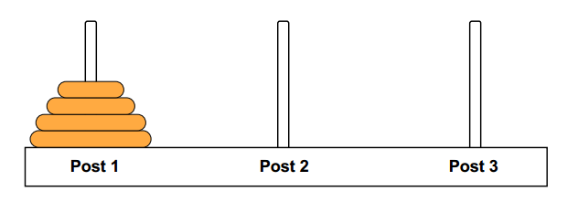
The Towers of Hanoi Puzzle
For n = 3, the fastest solution is:
Move from Left Post to Right Post
Move from Left Post to Middle Post
Move from Right Post to Middle Post
Move from Left Post to Right Post
Move from Middle Post to Left Post
Move from Middle Post to Right Post
Move From Left Post to Right Post
The minimum required number of moves is 7.

Slide 16
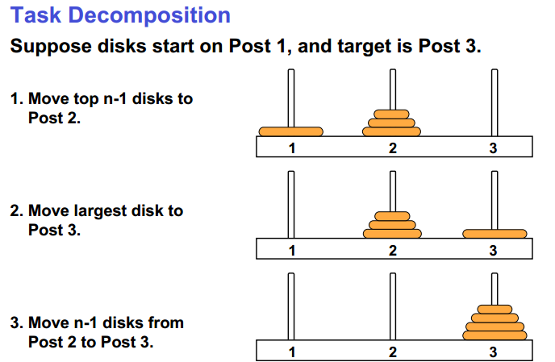
Making an Algorithm

Slide 17
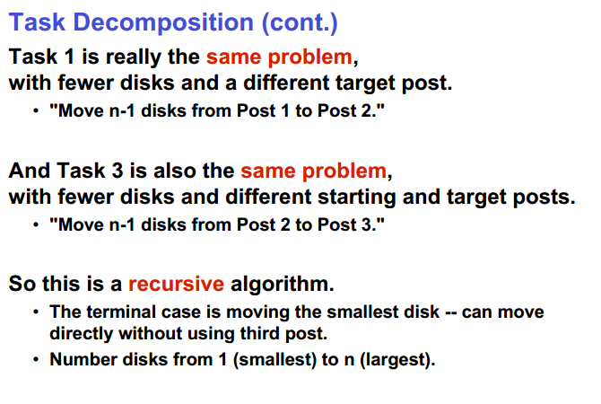

Slide 18
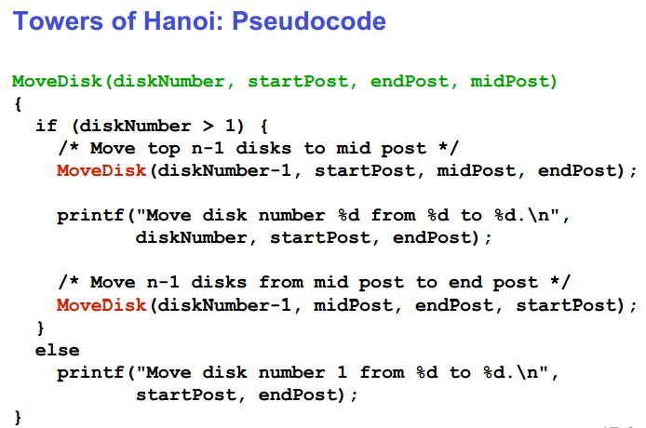
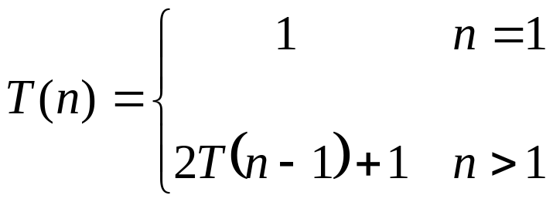

Slide 19
The Towers of Hanoi Puzzle
T(n)=
Notes:
Divide and Conquer

Slide 20
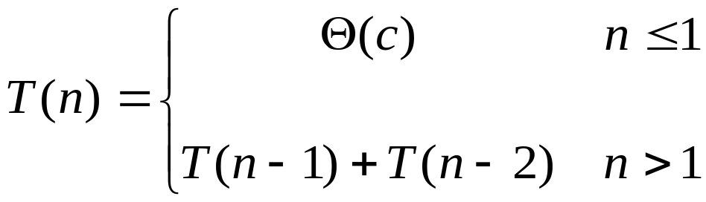
Fibonacci Sequence
Fib(n)
if ( n<=1)
return n
return (Fib(n-1) + Fib(n-2))
Recurrence Equation:

Slide 21
Fibonacci Sequence
What is the drawback in recursive algorithms?
F(n)
F(n-1)
F(n-2)
F(n-2)
F(n-3)
F(n-3)
F(n-4)
F(0)
F(1)
F(1)
F(0)

Slide 22
Recursion Tree Method
Although substitution method can provide a sufficient proof that a solution to a recurrence is correct, sometimes difficult to give a good guess.
Draw a recursion tree
  straight forward way to devise a good guess.
In recursion tree, nodes represent costs of a sub-problems in the set of recursive function invocations.
Sum up processing done at each level of the tree
Then sum all per-level costs to determine the total cost of all levels of the recursion.
Useful when recurrence describes running time of divide and conquer algorithms.

Slide 23
Recursion Tree Method
Using recursion tree to generate a good guess, we can often tolerate a small amount of sloppiness since we have to verify it later on.
If we are careful when drawing out a recursion tree and summing costs, then we can use a recursion tree as a direct proof of a solution to any recurrence of any problem.

Slide 24
Recursion Tree for
Binary Search
Problem size
Cost per stage
n
O(1)
n/2
O(1)
n/4
O(1)
log n
…
…
1
O(1)
Θ(log n)
Divide-and-Conquer

Slide 25

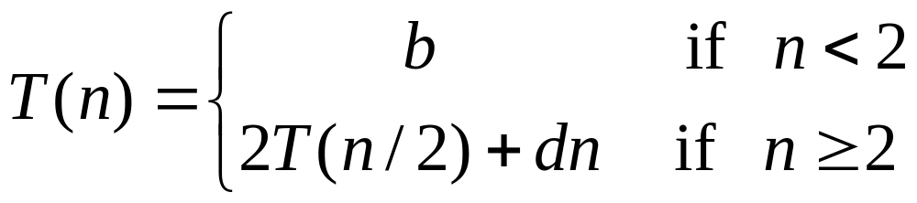
Example: Recursion Tree
The recursion tree is of the form:
where d > 0 is constant.
And the base case has a running time b
Divide-and-Conquer

Slide 26
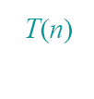
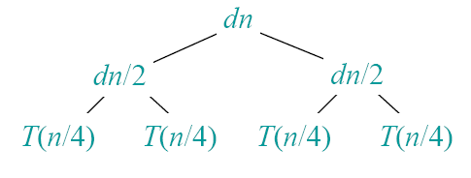
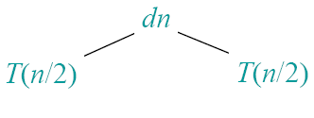
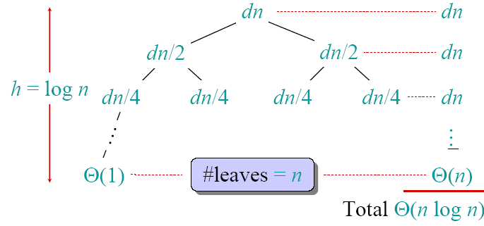
Drawing the Recursion Tree
With:
b
bn
bn + dn logn
Divide-and-Conquer

Slide 27

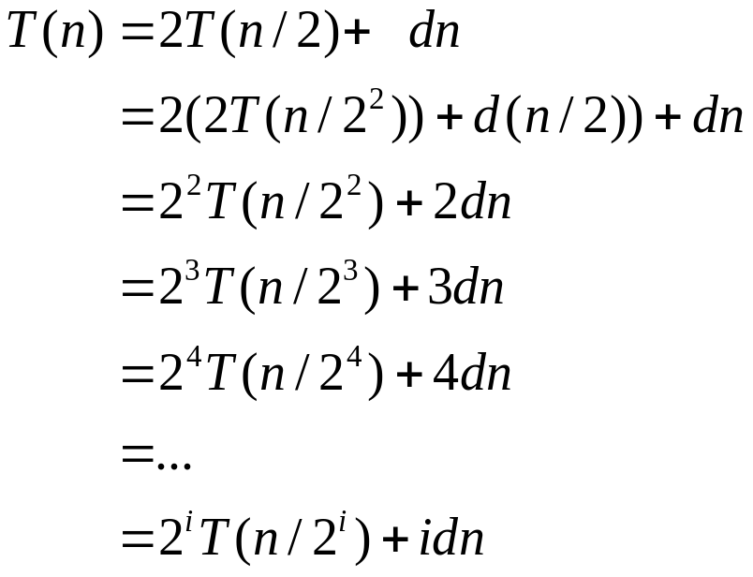

Iterative Substitution for
The recursion tree
In the iterative substitution, or “plug-and-chug,” technique, we iteratively apply the recurrence equation to itself and see if we can find a pattern:
Note that base, T(n)=b, case occurs when 2^{i}=n. That is, i = log n.
So,
Thus, T(n) is O(n log n).
Divide-and-Conquer

Slide 28
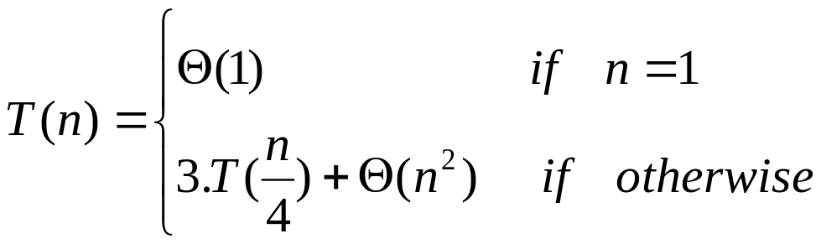
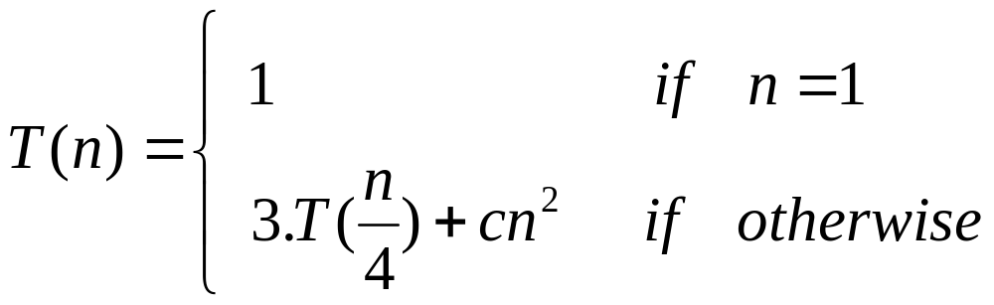
Recursion Tree Method
Example:
Solve the following recurrence using recurrence tree method
Solution: The above recurrence can be written in the form
Assumption: We assume that n is exact power of 4.
The recurrence tree is given in the next slide

Slide 29
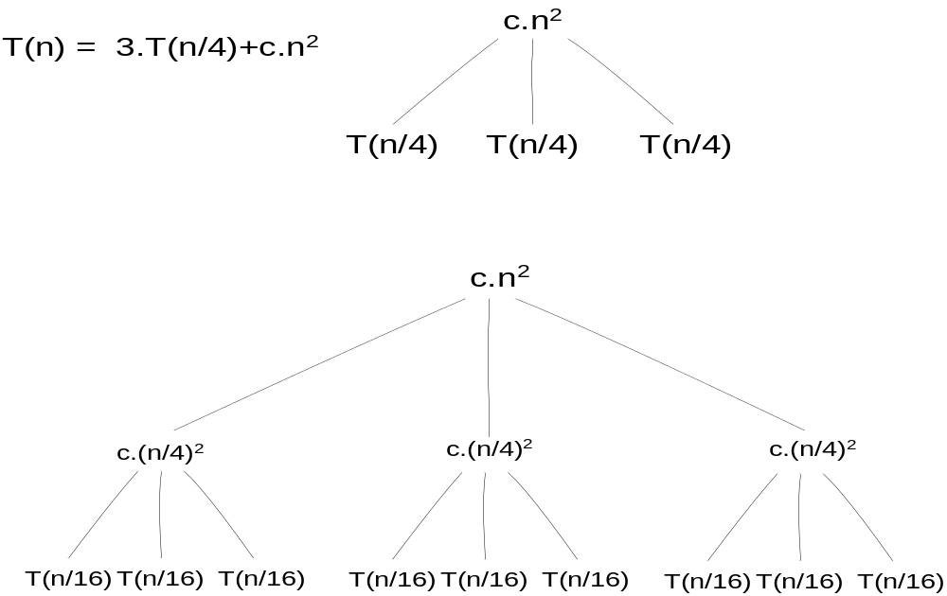
Recursion Tree Method

Slide 30
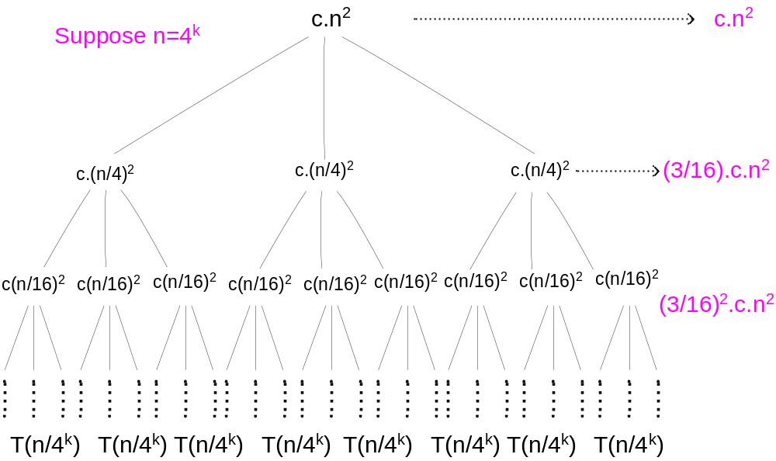
Recursion Tree Method

Slide 31
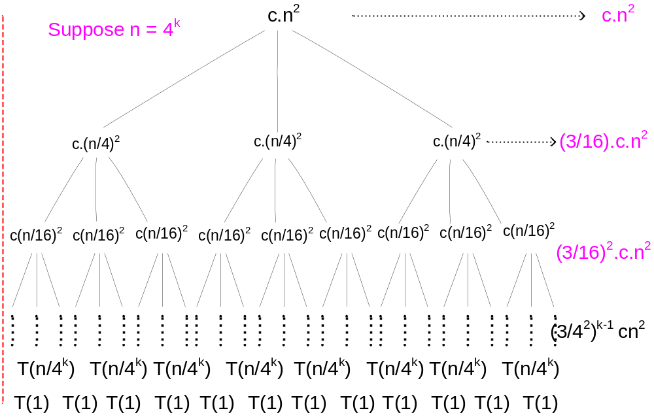
Recursion Tree Method
Θ(n^{log}₄³⁾

Slide 32

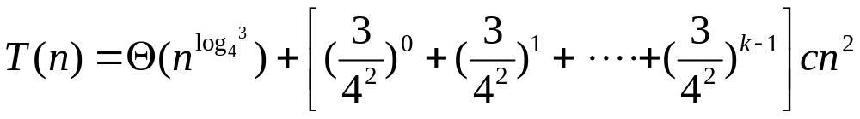
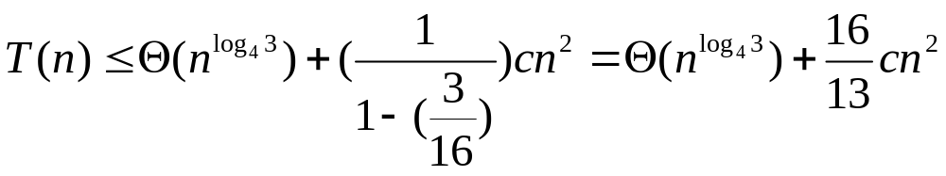

Recursion Tree Method
Total computation cost = Cost of Children
+ Cost of tree excluding children
= Cost of Child x total number of Children
+ Cost of all levels excluding children level
= total number of Children + sum of costs at each
level excluding children level.

Slide 33
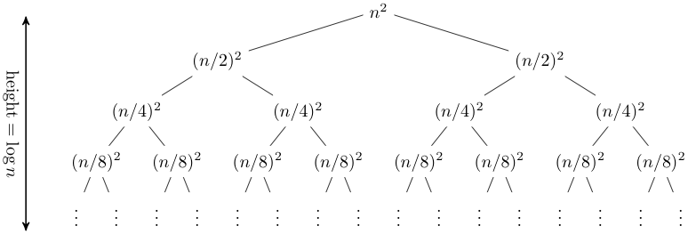
Recursion Tree Method
T(n) = 2T(n/2) + n².

Slide 34
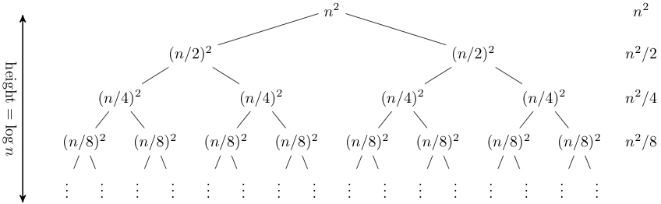
Recursion Tree Method

Slide 35
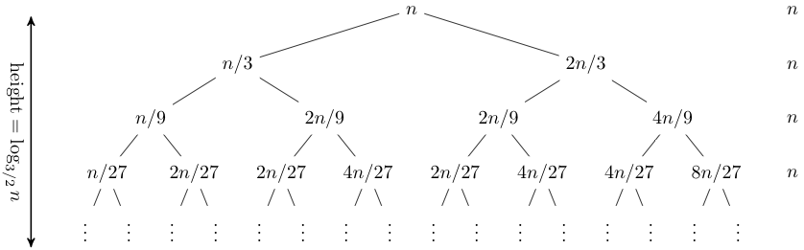
Recursion Tree Method
T(n) = T(n/3) + T(2n/3) + n.

Slide 36
Recursion Tree Method
Solve T(n) = T(n/4) + T(n/2) + n²:

Slide 37
Recursion Tree Method
Solve T(n) = T(n/4) + T(n/2) + n²:
T(n)

Slide 38
Recursion Tree Method
Solve T(n) = T(n/4) + T(n/2) + n²:
n²
T(n/4)
T(n/2)

Slide 39
Recursion Tree Method
Solve T(n) = T(n/4) + T(n/2) + n²:
n²
(n/4)²
(n/2)²
T(n/16)
T(n/8)
T(n/8)
T(n/4)

Slide 40
Recursion Tree Method
Solve T(n) = T(n/4) + T(n/2) + n²:
n²
(n/4)²
(n/2)²
(n/16)²
(n/8)²
(n/8)²
(n/4)²
…
Θ(1)

Slide 41

Recursion Tree Method
Solve T(n) = T(n/4) + T(n/2) + n²:
n²
(n/4)²
(n/2)²
(n/16)²
(n/8)²
(n/8)²
(n/4)²
…
Θ(1)

Slide 42
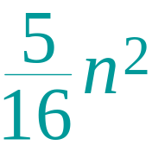
Recursion Tree Method
Solve T(n) = T(n/4) + T(n/2) + n²:
n²
(n/4)²
(n/2)²
(n/16)²
(n/8)²
(n/8)²
(n/4)²
…
Θ(1)

Slide 43
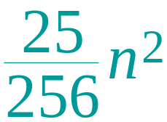
Recursion Tree Method
Solve T(n) = T(n/4) + T(n/2) + n²:
n²
(n/4)²
(n/2)²
(n/16)²
(n/8)²
(n/8)²
(n/4)²
…
…
Θ(1)

Slide 44
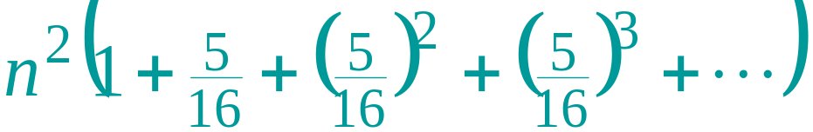
Recursion Tree Method
Solve T(n) = T(n/4) + T(n/2) + n²:
n²
(n/4)²
(n/2)²
(n/16)²
(n/8)²
(n/8)²
(n/4)²
…
…
Θ(1)
Total =
= Θ(n²)
geometric series

Slide 45
The divide-and-conquer design paradigm
Modified from: Carola Wenk, University of Texas at San Antonio
Divide the problem (instance) into subproblems.
  a subproblems, each of size n/b
Conquer the subproblems by solving them recursively. The base case has a runtime c
Combine subproblem solutions. Runtime is f(n)
Divide-and-Conquer

Slide 46

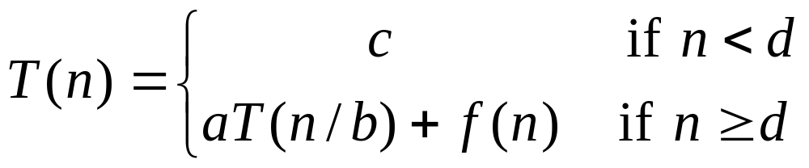
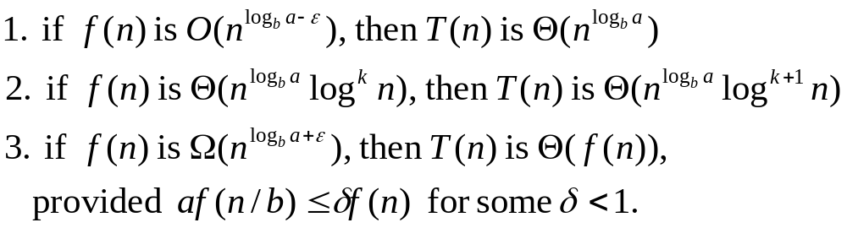
Master Method
Many divide-and-conquer recurrence equations have the form:
The Master Theorem:
Divide-and-Conquer

Slide 47
ϵ > 0 is a constant.
Each of the above conditions can be interpreted as:
Simply put, if f(n) is polynomially smaller than n^{logb​a}, then n^{logb​a} dominates, and the runtime is Θ(n^{logb​a}). If f(n) is instead polynomially larger than nlogb​a, then f(n) dominates, and the runtime isΘ(f(n)). Finally, if f(n) and nlogb​a are asymptotically the same, then T(n) = Θ(n^{log}_{b}^{​a}logn).
Divide-and-Conquer

Slide 48
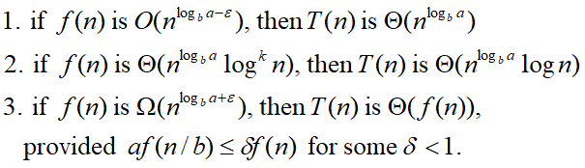
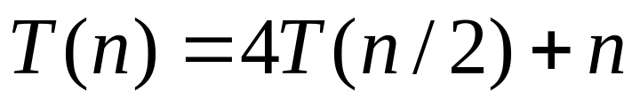
Master Method, Example 1
The form:
The Master Theorem:
Example:
Solution: log_{b}a=2, so case 1 says T(n) is O(n²).
Divide-and-Conquer

Slide 49
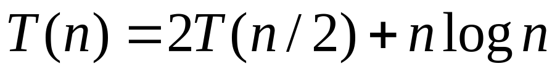
Master Method, Example 2
The form:
The Master Theorem:
Example:
Solution: log_{b}a=1, so case 2 says T(n) is O(n log² n).
Divide-and-Conquer

Slide 50
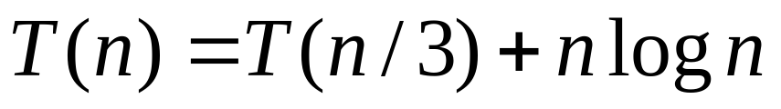
Master Method, Example 3
The form:
The Master Theorem:
Example:
Solution: log_{b}a=0, so case 3 says T(n) is O(n log n).
Divide-and-Conquer

Slide 51
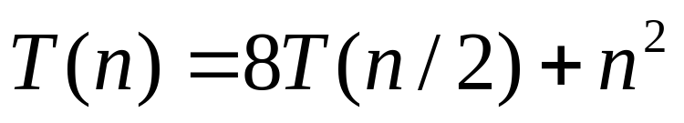
Master Method, Example 4
The form:
The Master Theorem:
Example:
Solution: log_{b}a=3, so case 1 says T(n) is O(n³).
Divide-and-Conquer

Slide 52
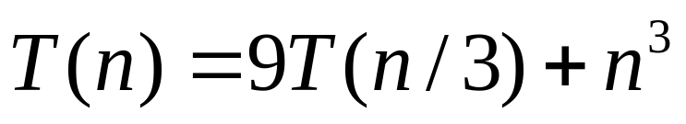
Master Method, Example 5
The form:
The Master Theorem:
Example:
Solution: log_{b}a=2, so case 3 says T(n) is O(n³).
Divide-and-Conquer

Slide 53
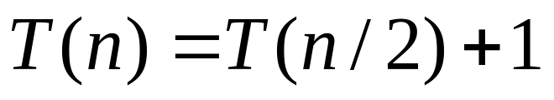
Master Method, Example 6
The form:
The Master Theorem:
Example:
(binary search)
Solution: log_{b}a=0, so case 2 says T(n) is O(log n).
Divide-and-Conquer

Slide 54
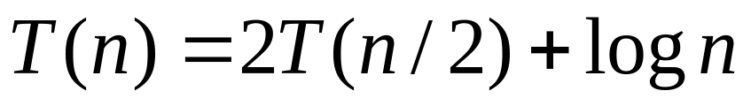
Master Method, Example 7
The form:
The Master Theorem:
Example:
(heap construction)
Solution: log_{b}a=1, so case 1 says T(n) is O(n).
Divide-and-Conquer

Slide 55
Divide-and-Conquer,
Algorithm Examples:
Merge Sort
Quick Sort
Divide-and-Conquer
Notes:
Divide and Conquer

Slide 56
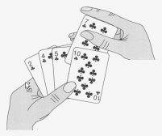
Merge Sort
7 2 ⏐ 9 4 → 2 4 7 9
7 ⏐ 2 → 2 7
9 ⏐ 4 → 4 9
7 → 7
2 → 2
9 → 9
4 → 4
Divide-and-Conquer
Notes:
Divide and Conquer

Slide 57
Outline
Merge-sort (§4.1.1)
  Algorithm
  Merging two sorted sequences
  Merge-sort tree
  Execution example
  Analysis
Generic merging and set operations (§4.2.1)
Divide-and-Conquer

Slide 58
Merge-Sort
Merge-sort is a sorting algorithm based on the divide-and-conquer paradigm
Like heap-sort
  It uses a comparator
  It has O(n log n) running time
Unlike heap-sort
  It does not use an auxiliary priority queue
  It accesses data in a sequential manner (suitable to sort data on a disk)
Divide-and-Conquer

Slide 59
Merge-Sort
Algorithm mergeSort(S, C)
Input sequence S with n elements, comparator C
Output sequence S sorted
  according to C
  if S.size() > 1
  (S₁, S₂) ← partition(S, n/2)
  mergeSort(S₁, C)
  mergeSort(S₂, C)
  S ← merge(S₁, S₂)
Merge-sort on an input sequence S with n elements consists of three steps:
  Divide: partition S into two sequences S₁ and S₂ of about n/2 elements each
  Recur: recursively sort S₁ and S₂
  Conquer: merge S₁ and S₂ into a unique sorted sequence
2T(n/2)
f(n)=bn
Base case:
merge(elem1,elem2)
Running time = b
Divide-and-Conquer

Slide 60
Merging Two Sorted Sequences
The conquer step of merge-sort consists of merging two sorted sequences A and B into a sorted sequence S containing the union of the elements of A and B
Merging two sorted sequences, each with n/2 elements and implemented by means of a doubly linked list, takes O(n) time
Algorithm merge(A, B)
Input sequences A and B with
n/2 elements each
Output sorted sequence of A ∪ B
  S ← empty sequence
  while ¬A.isEmpty() ∧ ¬B.isEmpty()
  if A.first().element() < B.first().element()
  S.insertLast(A.remove(A.first()))
  else
  S.insertLast(B.remove(B.first()))
  while ¬A.isEmpty() S.insertLast(A.remove(A.first()))
  while ¬B.isEmpty() S.insertLast(B.remove(B.first()))
  return S
Divide-and-Conquer

Slide 61
Merge-Sort Tree
An execution of merge-sort is depicted by a binary tree
  each node represents a recursive call of merge-sort and stores
    unsorted sequence before the execution and its partition
    sorted sequence at the end of the execution
  the root is the initial call
  the leaves are calls on subsequences of size 0 or 1
7 2 ⏐ 9 4 → 2 4 7 9
7 ⏐ 2 → 2 7
9 ⏐ 4 → 4 9
7 → 7
2 → 2
9 → 9
4 → 4
Divide-and-Conquer

Slide 62
Execution Example
Partition
7 2 9 4 ⏐ 3 8 6 1 → 1 2 3 4 6 7 8 9
7 2 9 4 → 2 4 7 9
3 8 6 1 → 1 3 8 6
7 2 → 2 7
9 4 → 4 9
3 8 → 3 8
6 1 → 1 6
7 → 7
2 → 2
9 → 9
4 → 4
3 → 3
8 → 8
6 → 6
1 → 1
Divide-and-Conquer

Slide 63
Execution Example (cont.)
Recursive call, partition
7 2 9 4 ⏐ 3 8 6 1 → 1 2 3 4 6 7 8 9
7 2 ⏐ 9 4 → 2 4 7 9
3 8 6 1 → 1 3 8 6
7 2 → 2 7
9 4 → 4 9
3 8 → 3 8
6 1 → 1 6
7 → 7
2 → 2
9 → 9
4 → 4
3 → 3
8 → 8
6 → 6
1 → 1
Divide-and-Conquer

Slide 64
Execution Example (cont.)
Recursive call, partition
7 2 9 4 ⏐ 3 8 6 1 → 1 2 3 4 6 7 8 9
7 2 ⏐ 9 4 → 2 4 7 9
3 8 6 1 → 1 3 8 6
7 ⏐ 2 → 2 7
9 4 → 4 9
3 8 → 3 8
6 1 → 1 6
7 → 7
2 → 2
9 → 9
4 → 4
3 → 3
8 → 8
6 → 6
1 → 1
Divide-and-Conquer

Slide 65
Execution Example (cont.)
Recursive call, base case
7 2 9 4 ⏐ 3 8 6 1 → 1 2 3 4 6 7 8 9
7 2 ⏐ 9 4 → 2 4 7 9
3 8 6 1 → 1 3 8 6
7 ⏐ 2 → 2 7
9 4 → 4 9
3 8 → 3 8
6 1 → 1 6
7 → 7
2 → 2
9 → 9
4 → 4
3 → 3
8 → 8
6 → 6
1 → 1
Divide-and-Conquer

Slide 66
Execution Example (cont.)
Recursive call, base case
7 2 9 4 ⏐ 3 8 6 1 → 1 2 3 4 6 7 8 9
7 2 ⏐ 9 4 → 2 4 7 9
3 8 6 1 → 1 3 8 6
7 ⏐ 2 → 2 7
9 4 → 4 9
3 8 → 3 8
6 1 → 1 6
7 → 7
2 → 2
9 → 9
4 → 4
3 → 3
8 → 8
6 → 6
1 → 1
Divide-and-Conquer

Slide 67
Execution Example (cont.)
Merge
7 2 9 4 ⏐ 3 8 6 1 → 1 2 3 4 6 7 8 9
7 2 ⏐ 9 4 → 2 4 7 9
3 8 6 1 → 1 3 8 6
7 ⏐ 2 → 2 7
9 4 → 4 9
3 8 → 3 8
6 1 → 1 6
7 → 7
2 → 2
9 → 9
4 → 4
3 → 3
8 → 8
6 → 6
1 → 1
Divide-and-Conquer

Slide 68
Execution Example (cont.)
Recursive call, …, base case, merge
7 2 9 4 ⏐ 3 8 6 1 → 1 2 3 4 6 7 8 9
7 2 ⏐ 9 4 → 2 4 7 9
3 8 6 1 → 1 3 8 6
7 ⏐ 2 → 2 7
9 4 → 4 9
3 8 → 3 8
6 1 → 1 6
7 → 7
2 → 2
9 → 9
4 → 4
3 → 3
8 → 8
6 → 6
1 → 1
Divide-and-Conquer

Slide 69
Execution Example (cont.)
Merge
7 2 9 4 ⏐ 3 8 6 1 → 1 2 3 4 6 7 8 9
7 2 ⏐ 9 4 → 2 4 7 9
3 8 6 1 → 1 3 8 6
7 ⏐ 2 → 2 7
9 4 → 4 9
3 8 → 3 8
6 1 → 1 6
7 → 7
2 → 2
9 → 9
4 → 4
3 → 3
8 → 8
6 → 6
1 → 1
Divide-and-Conquer

Slide 70
Execution Example (cont.)
Recursive call, …, merge, merge
7 2 9 4 ⏐ 3 8 6 1 → 1 2 3 4 6 7 8 9
7 2 ⏐ 9 4 → 2 4 7 9
3 8 6 1 → 1 3 6 8
7 ⏐ 2 → 2 7
9 4 → 4 9
3 8 → 3 8
6 1 → 1 6
7 → 7
2 → 2
9 → 9
4 → 4
3 → 3
8 → 8
6 → 6
1 → 1
Divide-and-Conquer

Slide 71
Execution Example (cont.)
Merge
7 2 9 4 ⏐ 3 8 6 1 → 1 2 3 4 6 7 8 9
7 2 ⏐ 9 4 → 2 4 7 9
3 8 6 1 → 1 3 6 8
7 ⏐ 2 → 2 7
9 4 → 4 9
3 8 → 3 8
6 1 → 1 6
7 → 7
2 → 2
9 → 9
4 → 4
3 → 3
8 → 8
6 → 6
1 → 1
Divide-and-Conquer

Slide 72
Analysis of Merge-Sort
The height h of the merge-sort tree is O(log n)
  at each recursive call we divide in half the sequence,
The overall amount or work done at the nodes of depth i is O(n)
  we partition and merge 2^{i} sequences of size n/2^{i}
  we make 2^{i+1} recursive calls
Thus, the total running time of merge-sort is O(n log n)
depth | #seqs | size
0 | 1 | n
1 | 2 | n/2
i | 2^{i} | n/2^{i}
… | … | …
Divide-and-Conquer

Slide 73
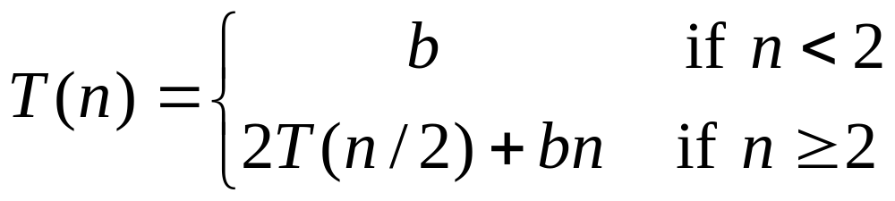
Recurrence Equation Analysis
The conquer step of merge-sort consists of merging two sorted sequences, each with n/2 elements and implemented by means of a doubly linked list, takes at most bn steps, for some constant b.
Likewise, the basis case (n < 2) will take at b most steps.
Therefore, if we let T(n) denote the running time of merge-sort:
We can therefore analyze the running time of merge-sort by finding a closed form solution to the above equation.
  That is, a solution that has T(n) only on the left-hand side.
Divide-and-Conquer

Slide 74
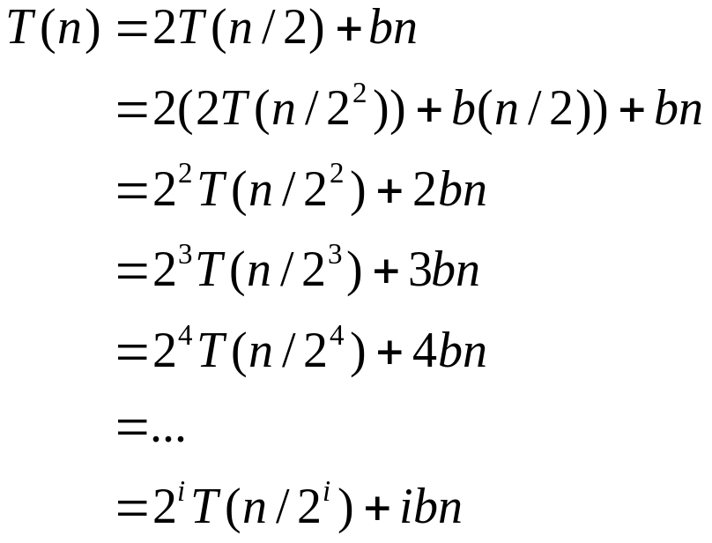

Iterative Substitution
In the iterative substitution, or “plug-and-chug,” technique, we iteratively apply the recurrence equation to itself and see if we can find a pattern:
Note that base, T(n)=b, case occurs when 2^{i}=n. That is, i = log n.
So,
Thus, T(n) is O(n log n).
Divide-and-Conquer

Slide 75
2. Quick-Sort
7 4 9 6 2 → 2 4 6 7 9
4 2 → 2 4
7 9 → 7 9
2 → 2
9 → 9
Divide-and-Conquer
Notes:
Divide and Conquer

Slide 76
Outline
Quick-sort (§4.3)
  Algorithm
  Partition step
  Quick-sort tree
  Execution example
Analysis of quick-sort (4.3.1)
In-place quick-sort (§4.8)
Summary of sorting algorithms
Divide-and-Conquer

Slide 77
Quick-Sort
Quick-sort is a randomized sorting algorithm based on the divide-and-conquer paradigm:
  Divide: pick a random element x (called pivot) and partition S into
    L elements less than x
    E elements equal x
    G elements greater than x
  Recur: sort L and G
  Conquer: join L, E and G
x
x
L
G
E
x
Divide-and-Conquer

Slide 78

Partition
We partition an input sequence as follows:
  We remove, in turn, each element y from S and
  We insert y into L, E or G, depending on the result of the comparison with the pivot x
Each insertion and removal is at the beginning or at the end of a sequence, and hence takes O(1) time
Thus, the partition step of quick-sort takes O(n) time
Algorithm partition(S, p)
Input sequence S, position p of pivot
Output subsequences L, E, G of the
elements of S less than, equal to,
or greater than the pivot, resp.
L, E, G ← empty sequences
  x ← S.remove(p)
  while ¬S.isEmpty()
  y ← S.remove(S.first())
  if y < x
  L.insertLast(y)
  else if y = x
  E.insertLast(y)
  else { y > x }
  G.insertLast(y)
  return L, E, G
Divide-and-Conquer

Slide 79
Quick-Sort Tree
An execution of quick-sort is depicted by a binary tree
  Each node represents a recursive call of quick-sort and stores
    Unsorted sequence before the execution and its pivot
    Sorted sequence at the end of the execution
  The root is the initial call
  The leaves are calls on subsequences of size 0 or 1
7 4 9 6 2 → 2 4 6 7 9
4 2 → 2 4
7 9 → 7 9
2 → 2
9 → 9
Divide-and-Conquer

Slide 80
Execution Example
Pivot selection
7 2 9 4 3 7 6 1 → 1 2 3 4 6 7 8 9
7 2 9 4 → 2 4 7 9
3 8 6 1 → 1 3 8 6
2 → 2
9 4 → 4 9
3 → 3
8 → 8
9 → 9
4 → 4
Divide-and-Conquer

Slide 81
Execution Example (cont.)
Partition, recursive call, pivot selection
7 2 9 4 3 7 6 1 → 1 2 3 4 6 7 8 9
2 4 3 1 → 2 4 7 9
3 8 6 1 → 1 3 8 6
2 → 2
9 4 → 4 9
3 → 3
8 → 8
9 → 9
4 → 4
Divide-and-Conquer

Slide 82
Execution Example (cont.)
Partition, recursive call, base case
7 2 9 4 3 7 6 1 → → 1 2 3 4 6 7 8 9
2 4 3 1 →→ 2 4 7
3 8 6 1 → 1 3 8 6
1 → 1
9 4 → 4 9
3 → 3
8 → 8
9 → 9
4 → 4
Divide-and-Conquer

Slide 83
Execution Example (cont.)
Recursive call, …, base case, join
7 2 9 4 3 7 6 1 → 1 2 3 4 6 7 8 9
2 4 3 1 → 1 2 3 4
3 8 6 1 → 1 3 8 6
1 → 1
4 3 → 3 4
3 → 3
8 → 8
9 → 9
4 → 4
Divide-and-Conquer

Slide 84
Execution Example (cont.)
Recursive call, pivot selection
7 2 9 4 3 7 6 1 → 1 2 3 4 6 7 8 9
2 4 3 1 → 1 2 3 4
7 9 7 1 → 1 3 8 6
1 → 1
4 3 → 3 4
8 → 8
9 → 9
9 → 9
4 → 4
Divide-and-Conquer

Slide 85
Execution Example (cont.)
Partition, …, recursive call, base case
7 2 9 4 3 7 6 1 → 1 2 3 4 6 7 8 9
2 4 3 1 → 1 2 3 4
7 9 7 1 → 1 3 8 6
1 → 1
4 3 → 3 4
8 → 8
9 → 9
9 → 9
4 → 4
Divide-and-Conquer

Slide 86
Execution Example (cont.)
Join, join
7 2 9 4 3 7 6 1 → 1 2 3 4 6 7 7 9
2 4 3 1 → 1 2 3 4
7 9 7 → 17 7 9
1 → 1
4 3 → 3 4
8 → 8
9 → 9
9 → 9
4 → 4
Divide-and-Conquer

Slide 87
Worst-case Running Time
The worst case for quick-sort occurs when the pivot is the unique minimum or maximum element
One of L and G has size n − 1 and the other has size 0
The running time is proportional to the sum
n + (n − 1) + … + 2 + 1
Thus, the worst-case running time of quick-sort is O(n²)
depth | time
0 | n
1 | n − 1
… | …
n − 1 | 1
…
Divide-and-Conquer

Slide 88
Expected Running Time
Consider a recursive call of quick-sort on a sequence of size s
  Good call: the sizes of L and G are each less than 3s/4
  Bad call: one of L and G has size greater than 3s/4
A call is good with probability 1/2
  1/2 of the possible pivots cause good calls:
7 2 9 4 3 7 6 1 9
2 4 3 1
7 9 7 1 → 1
7 2 9 4 3 7 6 1
Good call
1
7 2 9 4 3 7 6
Bad call
1 2 3 4 5 6 7 8 9 10 11 12 13 14 15 16
Bad pivots
Good pivots
Bad pivots
Divide-and-Conquer

Slide 89
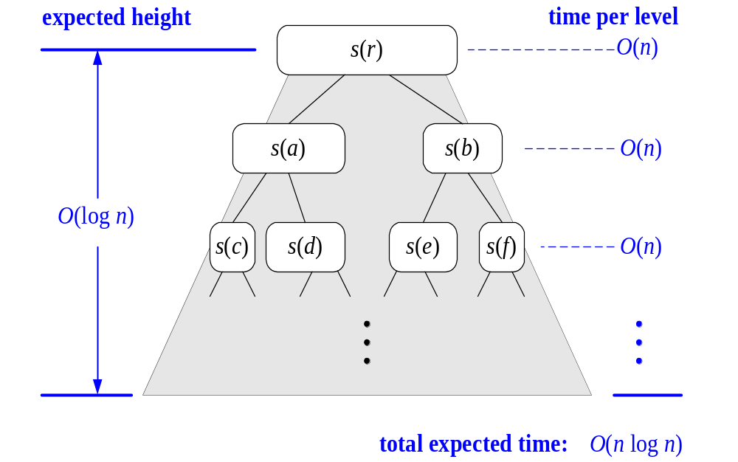
Expected Running Time, Part 2
Probabilistic Fact: The expected number of coin tosses required in order to get k heads is 2k
For a node of depth i, we expect
  i/2 ancestors are good calls
  The size of the input sequence for the current call is at most (3/4)^{i/2}n
Therefore, we have
  For a node of depth 2log_{4/3}n, the expected input size is one
  The expected height of the quick-sort tree is O(log n)
The amount or work done at the nodes of the same depth is O(n)
Thus, the expected running time of quick-sort is O(n log n)
Divide-and-Conquer

Slide 90
Binary Tree Algorithms
Binary tree is a divide-and-conquer ready structure!
Ex. 1: Classic traversals (preorder, inorder, postorder)
Algorithm Inorder(T)
if T ≠ ∅ a a
Inorder(T_{left}) b c b c
print(root of T) d e   d e
Inorder(T_{right})    
Efficiency: Θ(n)

Slide 91
Binary Tree Algorithms
Algorithm Preorder(T)
//Implements the preorder traversal of a binary tree
//Input: Binary tree T (with labeled vertices)
//Output: Node labels listed in preorder
If T ≠ Ф
print label of T’s root
preorder(T_{L} ) // T_{L} is the root’s left subtree
preorder(T_{R} ) // T_{R} is the root’s right subtree
The number of calls, C(n), made by the algorithm is equal to the number of nodes, both internal and external, in the extended tree. Hence according to the formula in the section ,C(n) = 2n + 1.

Slide 92
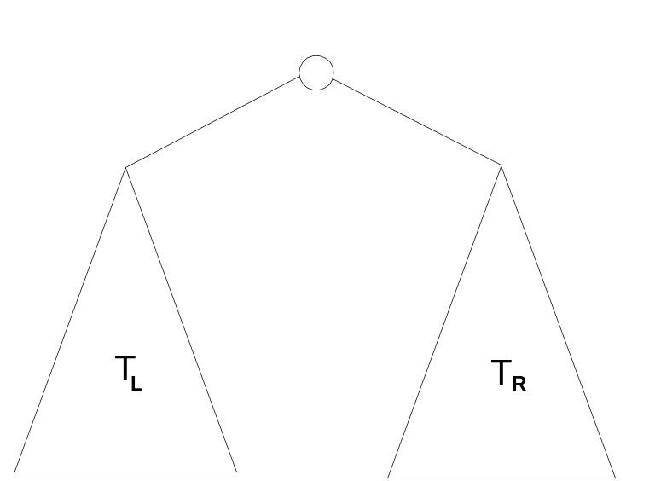
Binary Tree Algorithms (cont.)
Ex. 2: Computing the height of a binary tree
h(T) = max{h(T_{L}), h(T_{R})} + 1 if T ≠ ∅ and h(∅) = -1
Efficiency: Θ(n)

Slide 93
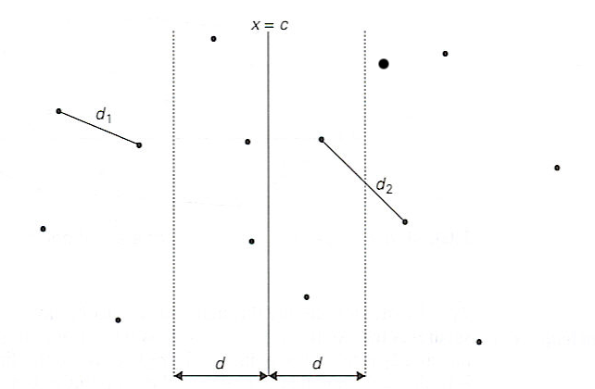
Closest Pair Problem
Step 1: Divide the points given into two subsets S1 and S2 by a vertical line x = c so that half the points lie to the left or on the line and half the points lie to the right or on the line.

Slide 94
Closest Pair Problem
Step 2 Find recursively the closest pairs for the left and right subsets.
Step 3 Set d = min {d1, d2}
Let C1 and C2 be the subsets of points in the left subset S1 and of the right subset S2, respectively, that lie in this vertical strip.
The points in C1 and C2 are stored in increasing order of their y coordinates, which is maintained by merging during the execution of the next step.
Step 4 For every point P(x,y) in C1, we inspect points in C2 that may be closer to P than d. There can be no more than 6 such points (because d ≤ d2)

Slide 95
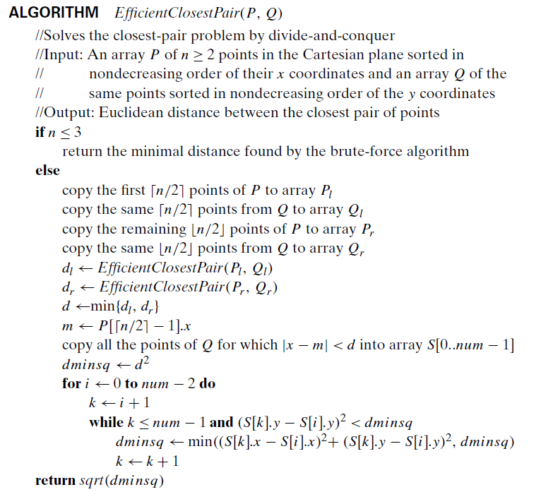
Closest Pair Problem
Divide-and-Conquer

Slide 96
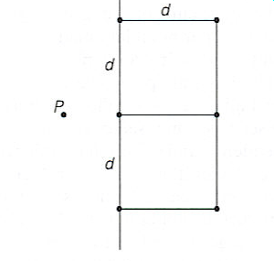
Closest Pair Problem
The worst case scenario is depicted below

Slide 97
Efficiency of the Closest Pair Problem
Running time of the algorithm
T(n) = 2T(n/2) + M(n),
where M(n) ∈ O(n)
By the Master Theorem
(with a = 2, b = 2, d = 1)
T(n) ∈ O(n log n)

Slide 98

Conclusions
Divide and conquer is just one of several powerful techniques for algorithm design.
Divide-and-conquer algorithms can be analyzed using recurrences and the master method (so practice this math).
Can lead to more efficient algorithms
Divide-and-Conquer

Slide 99
Exercise and Practice Questions
Divide-and-Conquer

Slide 100
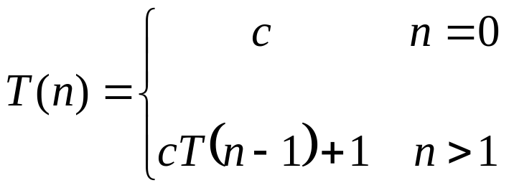
Recurrence Example: n^{Y}
Power (n, y)
{
if (y == 0)
return 1;
else
return (n * Power(n, y-1));
}
The expression:

Slide 101



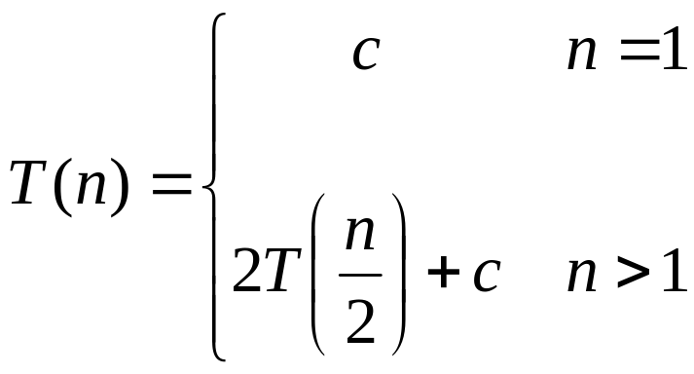
Recurrence Examples

Slide 102
Running Time of Recurrence Equation
Algorithm min1(a[1],a[2],…,a[n]):
1. If n = = 1, return a[1].
2. m ← min1(a[1],a[2],…,a[n-1] );
3. If m > a[n], return a[n], else return m
Now, let’s count the number of comparisons.
Steps 1 and 3 will run in constant time Θ(c).
Step 2 will run time recurrence on an input of size n-1
  T(n) = T(n -1) + Θ(c);
  T(1) = 1;

Slide 103
Linear Search
LinearSearch ( A, key, low, high)
{
if ( A[low]=key)
return low;
else if ( low> high)
return (–1)
else LinearSearch(A,key,low+1, high);
}
Note: Key Cost in any search Algorithm is no. of comparisons
Recurrence Equation:
T(n) = T(n-1) + 1

